Slide 1

World data
Power BI Assessment
WORLD DATA
POWER BI ASSESSMENT

Slide 2
PURPOSE
To unlock the full potential of data
Data Analysis
Decision Making
Visualization Storytelling

Slide 3

Data Analysis
Data Preparation
Data Modeling
Data Visualization
Data Analysis

Slide 4
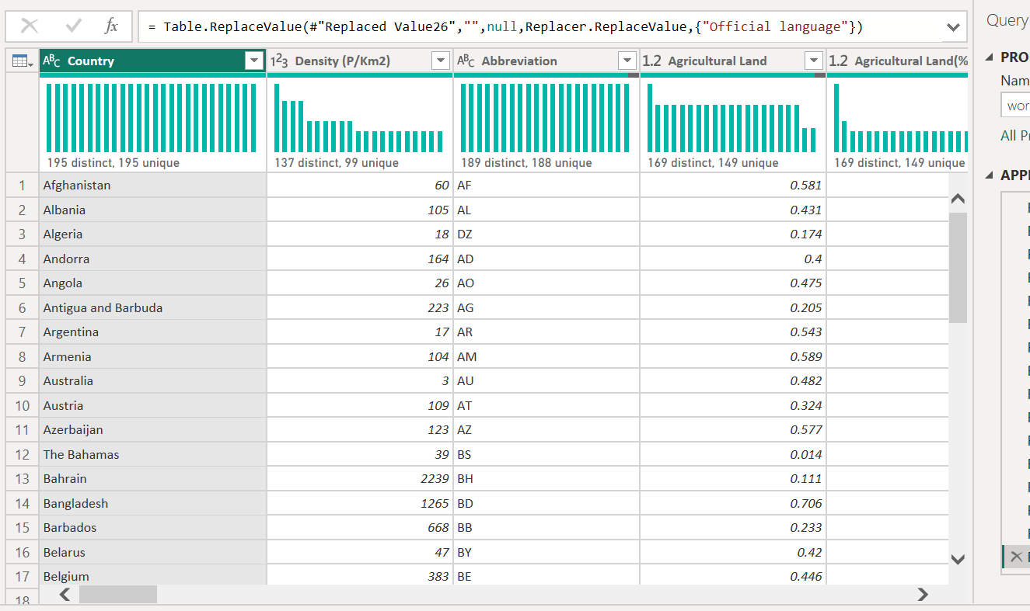
World data 2023 Dataset

Slide 5


Slide 10
Data Analysis
What are the best places to live in the world?
Employment opportunities
School & Education System
Cost of Living
Life Expectancy

Slide 11
Conclusion
Japan - highest Life Expectancy
Tuvalu and Lichtenstein - lowest CO2 Emission
China , US, India - Highest CO2 Emission
US, China, Japan – Wealthiest Countries
The highest Unemployment rate ,
slow Economic Grow – US, Spain, Turkey
Strong state in Economy – Switzerland, Netherlands.

